Slide 1

Group 3
Elliot Chester, Adam Speers, Matt Fisher, Lenneth Dayaon

Slide 2

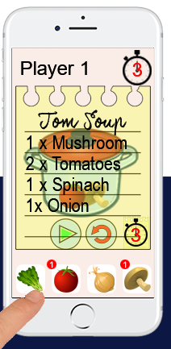
Core mechanics
2D Cooking Game
Symmetrical
Turn Based Competitive
Cognitive Memory Gameplay
Notes:
This will include our prototype and just a few words to describe it

Slide 3

How We Changed the game based on feedBack
It was too easy
Player 2 couldn’t read the recipes
It wasn’t clear who was winning
Notes:
Feedback from play testers, what to add, what to take away

Slide 4
How We Changed the game based on feedBack
Its too easy
We added a red herring
Player 2 can’t read the recipe
It’s not clear who’s winning
Notes:
Feedback from play testers, what to add, what to take away

Slide 5
How We Changed the game based on feedBack
Its too easy
We added a red herring
Player 2 can’t read the recipe
We flipped the recipe card for player 2
It’s not clear who’s winning
Notes:
Feedback from play testers, what to add, what to take away

Slide 6
How We Changed the game based on feedBack
Its too easy
We added a red herring
Player 2 can’t read the recipe
We flipped the recipe card for player 2
It’s not clear who’s winning
Each player now has a couple to make happy
Notes:
Feedback from play testers, what to add, what to take away

Slide 7
Any Questions?

